Slide 1
Microsoft Excel Power Query
Kyle Pew

Slide 2





WHAT IS POWER QUERY?
Power Query is a data connection feature, within Microsoft Excel, that enables Excel users to discover, connect, combine and transform data sources to meet your reporting needs.
DISCOVER/
CONNECT
TRANSFORM
MERGE/
COMBINE
SHARE

Slide 3
WHAT IS POWER QUERY?
Power Query is a data connection feature, within Microsoft Excel, that enables Excel users to discover, connect, combine and transform data sources to meet your reporting needs.
DISCOVER/
CONNECT
TRANSFORM
MERGE/
COMBINE
SHARE

Slide 4
WHAT IS POWER QUERY?
Power Query is a data connection feature, within Microsoft Excel, that enables Excel users to discover, connect, combine and transform data sources to meet your reporting needs.
DISCOVER/
CONNECT
TRANSFORM
MERGE/
COMBINE
SHARE

Slide 5
WHAT IS POWER QUERY?
Power Query is a data connection feature, within Microsoft Excel, that enables Excel users to discover, connect, combine and transform data sources to meet your reporting needs.
DISCOVER/
CONNECT
TRANSFORM
MERGE/
COMBINE
SHARE

Slide 6
WHAT IS POWER QUERY?
Power Query is a data connection feature, within Microsoft Excel, that enables Excel users to discover, connect, combine and transform data sources to meet your reporting needs.
DISCOVER/
CONNECT
TRANSFORM
MERGE/
COMBINE
SHARE

Slide 7
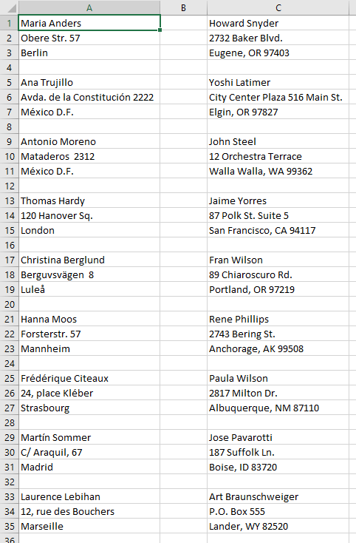
THE POWER OF POWER QUERY

Slide 8
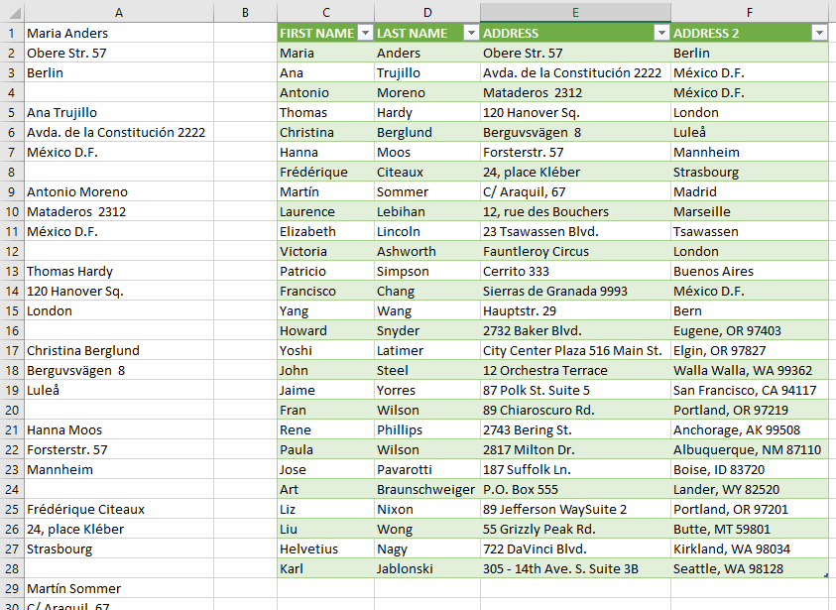
THE POWER OF POWER QUERY

Slide 9



DOWNLOAD POWER QUERY
Power Query is built into Excel 2016, 2019, Office 365
The feature is available on the DATA tab under GET AND TRANSFORM
Power Query is also available for Excel 2010 and 2013 through a free download from Microsoft.
2010
2013
https://www.microsoft.com/en-us/download/details.aspx?id=39379

Slide 10
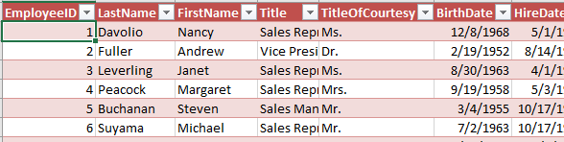
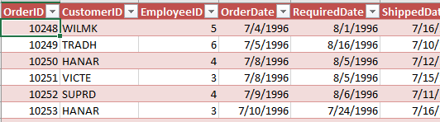
TABLE RELATIONSHIPS
EMPLOYEE DATA
ORDER DATA

Slide 11
TABLE RELATIONSHIPS
EMPLOYEE DATA
ORDER DATA

Slide 12
TABLE RELATIONSHIPS
EMPLOYEE DATA
LEFT
ORDER DATA
RIGHT

Slide 13
TABLE RELATIONSHIPS
EMPLOYEE DATA
ORDER DATA
LEFT
RIGHT

Slide 14
TABLE RELATIONSHIPS
EMPLOYEE DATA
ORDER DATA
LEFT
RIGHT

Slide 15
TABLE RELATIONSHIPS/JOINS
LEFT OUTER
INNER JOIN
RIGHT OUTER
EMPLOYEE DATA
ORDER DATA
LEFT
RIGHT

Slide 16
TABLE RELATIONSHIPS/JOINS
LEFT OUTER
INNER JOIN
RIGHT OUTER
EMPLOYEE DATA
ORDER DATA
LEFT
RIGHT
EMPLOYEE ID

Slide 17
TABLE RELATIONSHIPS/JOINS
LEFT OUTER
INNER JOIN
RIGHT OUTER
EMPLOYEE DATA
ORDER DATA
LEFT
RIGHT
EMPLOYEE ID

Slide 18
TABLE RELATIONSHIPS/JOINS
RIGHT OUTER
LEFT OUTER
INNER JOIN
EMPLOYEE DATA
ORDER DATA
LEFT
RIGHT
EMPLOYEE ID

Slide 19
TABLE RELATIONSHIPS/JOINS
INNER JOIN
LEFT OUTER
RIGHT OUTER
EMPLOYEE DATA
ORDER DATA
LEFT
RIGHT
EMPLOYEE ID

Slide 20

CONGRATULATIONS
EXCEL POWER QUERY

